Slide 1
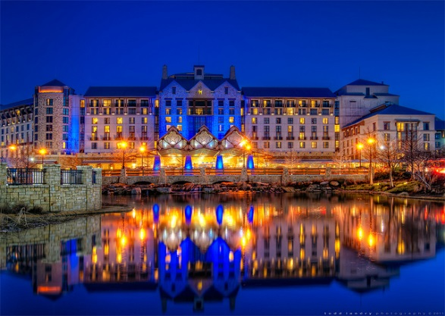
Grapevine Economic Development

Slide 2
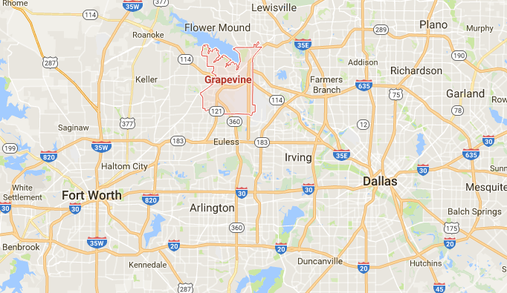
How great is grapevine?
The Most Valuable
LOCATION
When someone says “Grapevine”, what do you think of?
The Obvious
DFW Airport
Grapevine Mills Mall
Historic Downtown Main Street
Hotels – Gaylord Texan, Great Wolf Lodge, etc.
Festivals and Events – GrapeFest, Christmas, and Main Street Days
The Less Obvious
Grapevine’s Industrial Park/Manufacturing
Restaurants – From Whataburger to Bob’s, Chipotle to Pappadeaux
Baylor Health System – Main campus in Grapevine
Grapevine CVB – 60+ employees (Arlington has 23)
Fieldhouse USA – Sports complex in Grapevine Mills Mall
Without our central location, there would be no:
DFW Airport
Grapevine Mills Mall
Hotel Cluster
Car Dealerships
TEX Rail
Destination Restaurants
Headquarters
Destination Retail
The Soon-To-Be Obvious
The 185 – Kubota, Stand Rock Hotel/Water Park, Salt Lick BBQ
TEX Rail – Rail line that connects DFW Airport, Grapevine, NRH and Downtown Ft. Worth

Slide 3
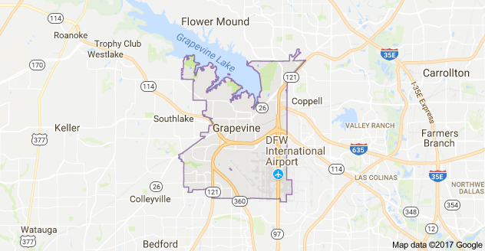
Grapevine’s Unique Dynamic
Every $1.00 the City receives from sales tax, approximately $0.83 comes from non-residents.
Local property tax is $0.231, among the lowest in the Metroplex.
People from outside of Grapevine feed into our economy, subsidizing the low tax rate.
Projects that create sales tax revenue while targeting non-residents are given special attention.
The Mall provides almost 1/3 of the City’s sales tax revenue each year.
Relying on sales tax provides a higher ceiling for collections, but potentially more volatile swings year to year.
City | Per $100 property valuation
Grapevine | $0.289
Arlington | $0.635
Bedford | $0.562
Colleyville | $0.321
Euless | $0.463
Haltom City | $0.653
Hurst | $0.580
Keller | $0.413
Southlake | $0.447

Slide 4
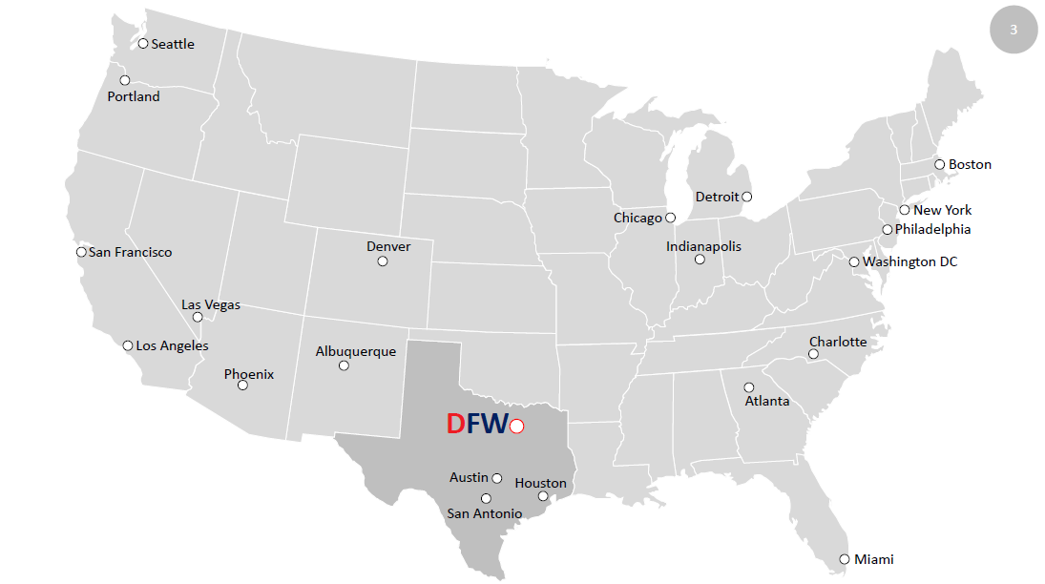

Slide 5
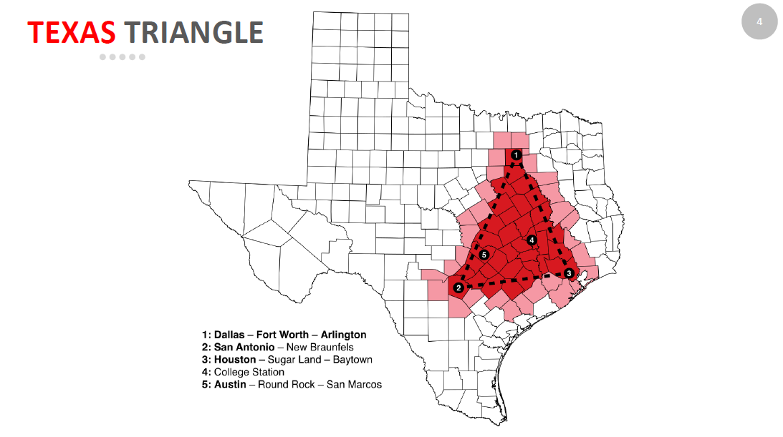

Slide 7
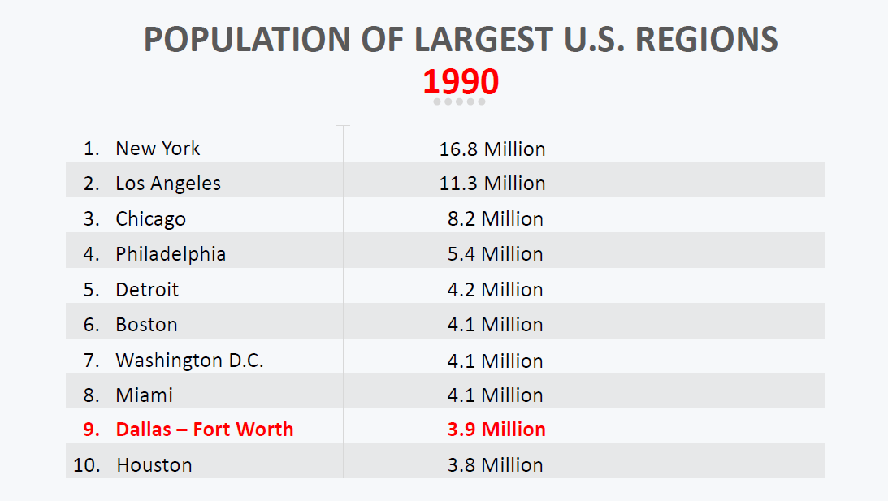

Slide 8
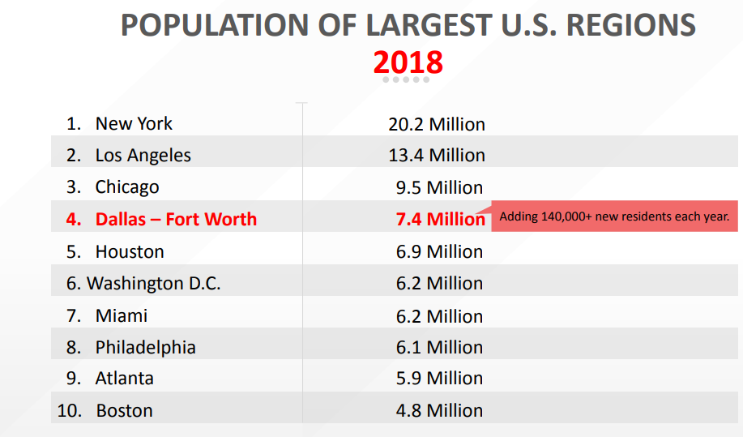

Slide 9
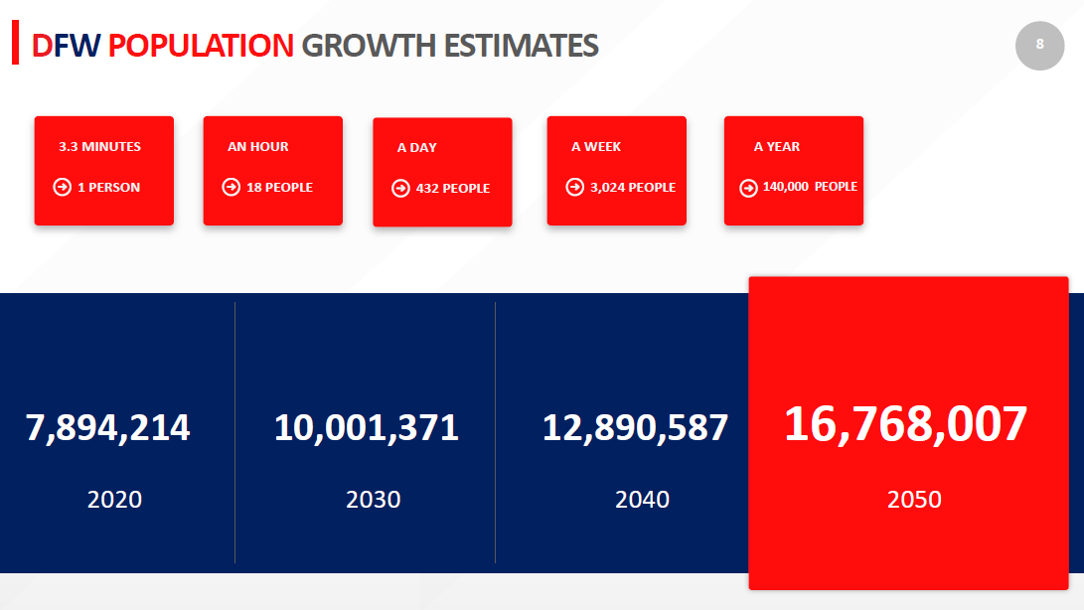

Slide 10
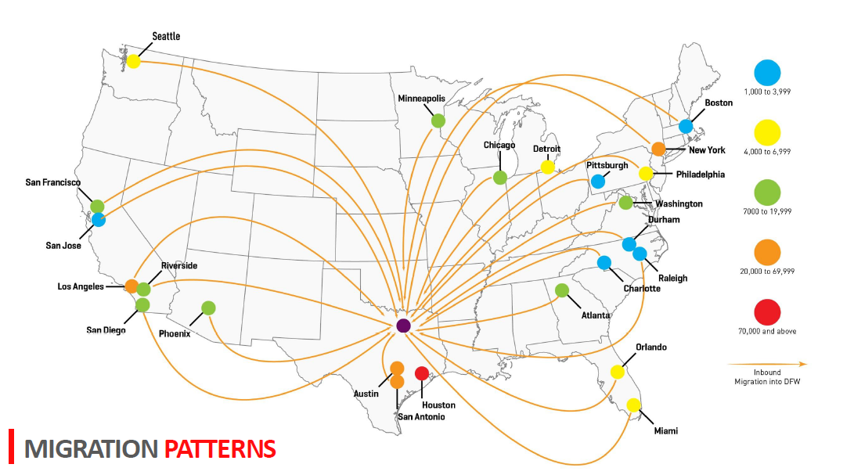

Slide 11
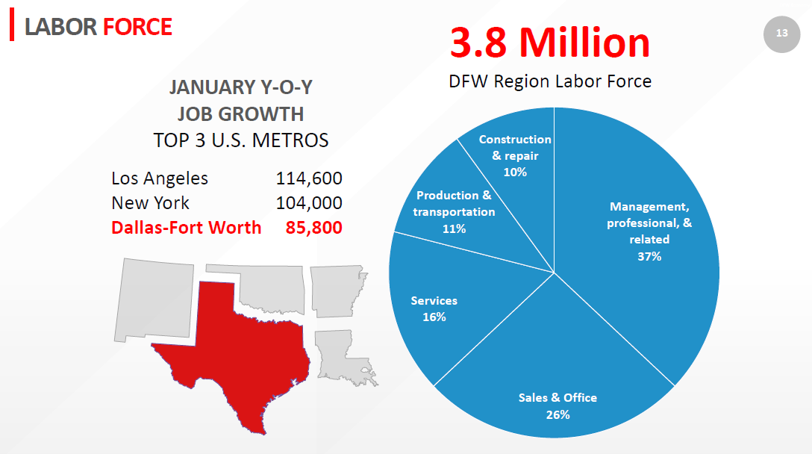

Slide 12
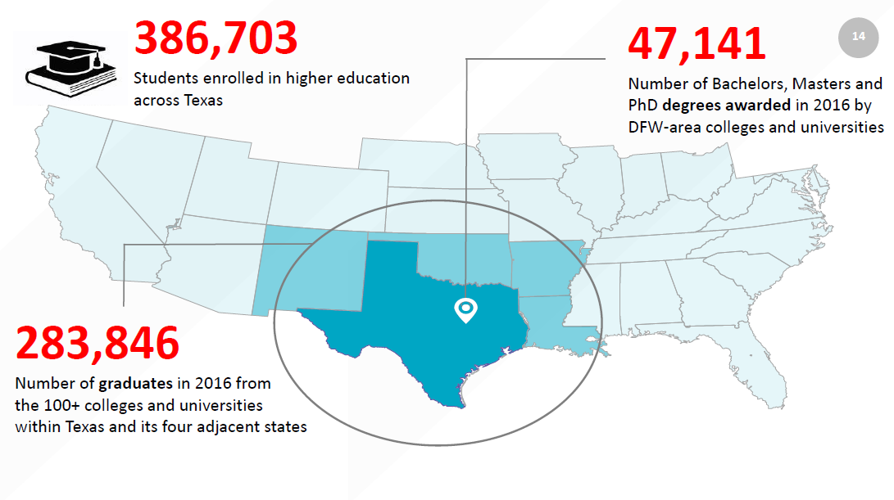

Slide 14
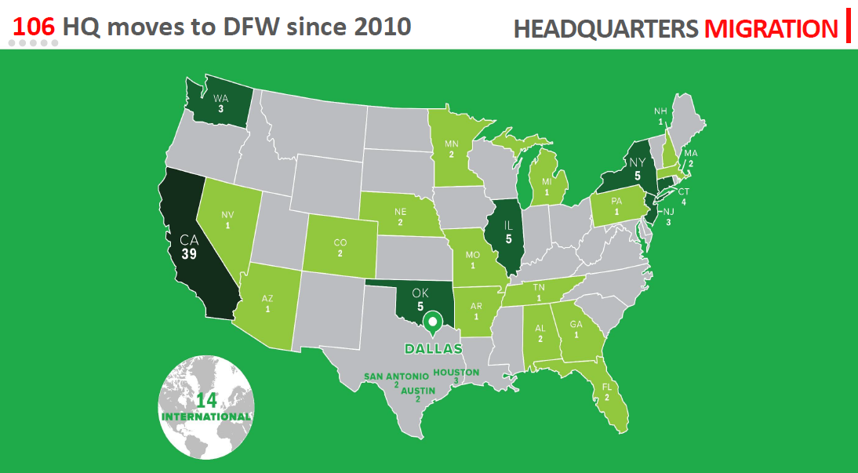

Slide 15
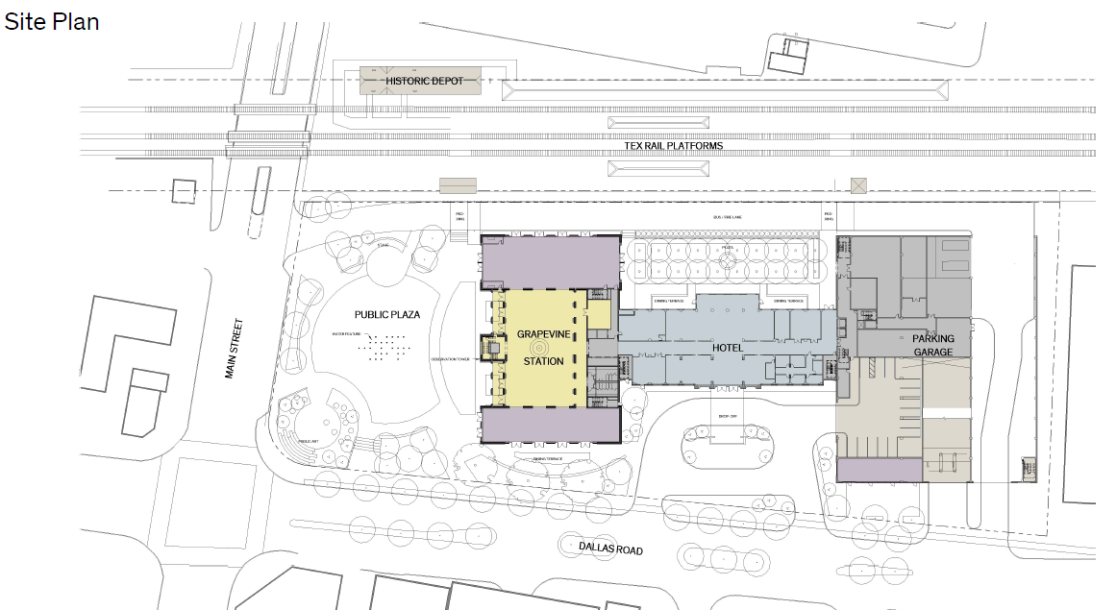
TEX Rail
Notes:
Meeting Sales Observations:
-Fort Worth Convention Center bookings:
2017: Room Nights 116% YTD Pace, # of events +4;
2018: Room Nights 111% YTD Pace, # of events -2
2019: Room Nights 92% YTD Pace, # of events -4
-FWCVB has a 22% conversion ratio on all bookings. Being above 20% is considered positive in the destination marketing industry.

Slide 16
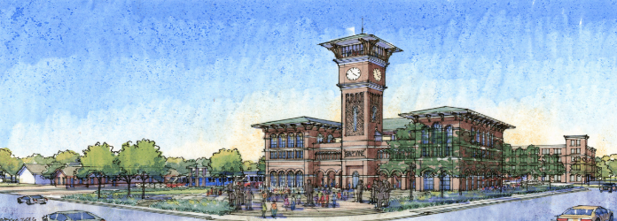
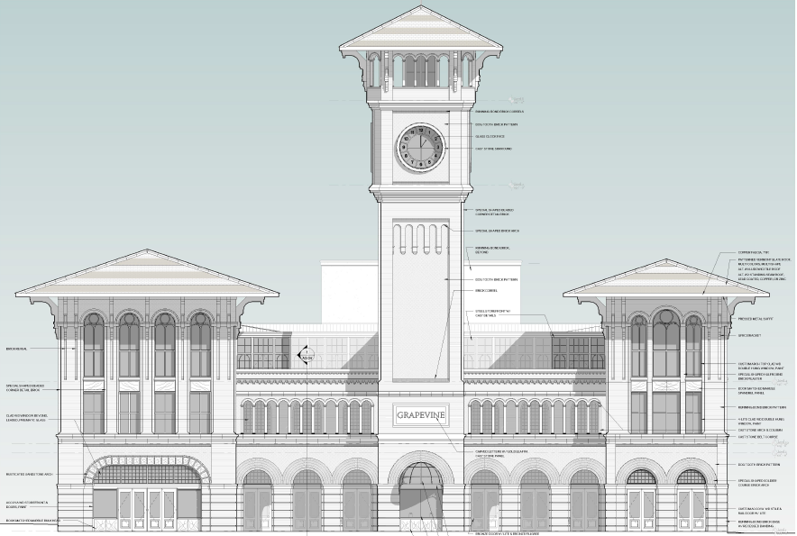
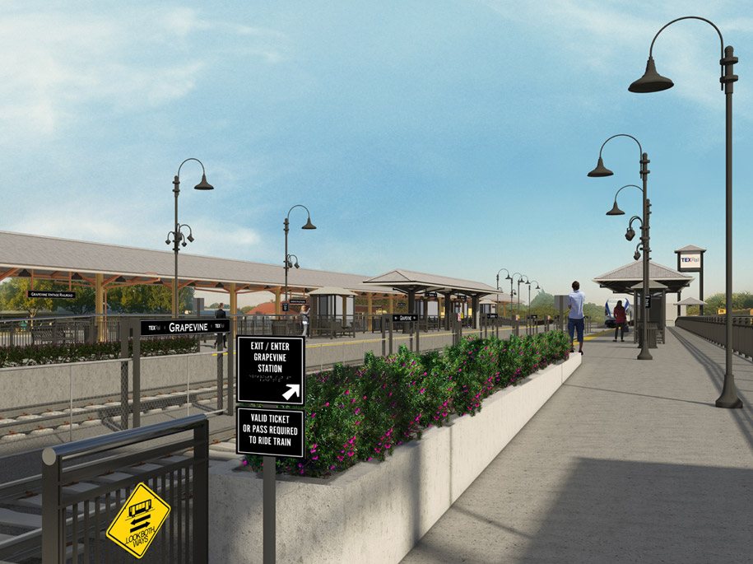
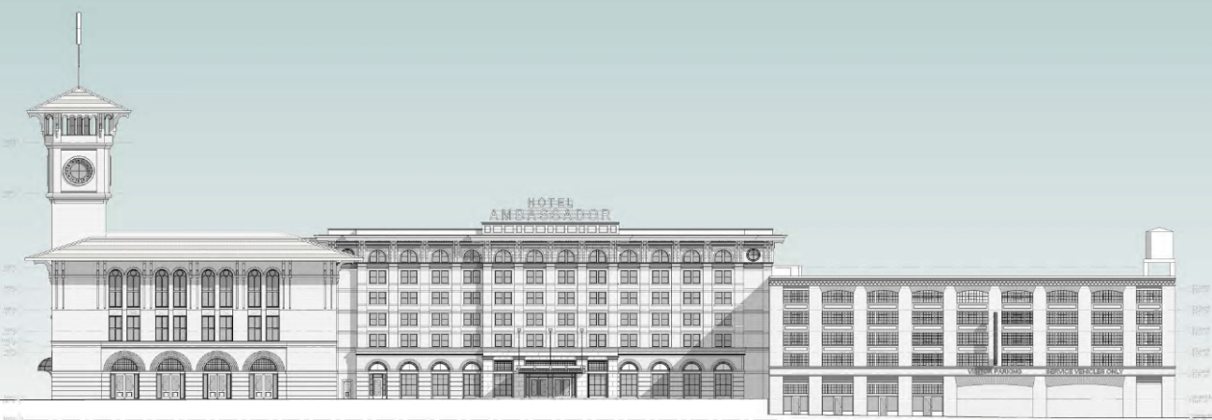
TEXRail - Grapevine
Grapevine Main Street Station
The station opened in early 2019.
It’s began with approximately 8,000 riders per day, with estimates of an increase to 13,000 over time.

Slide 17
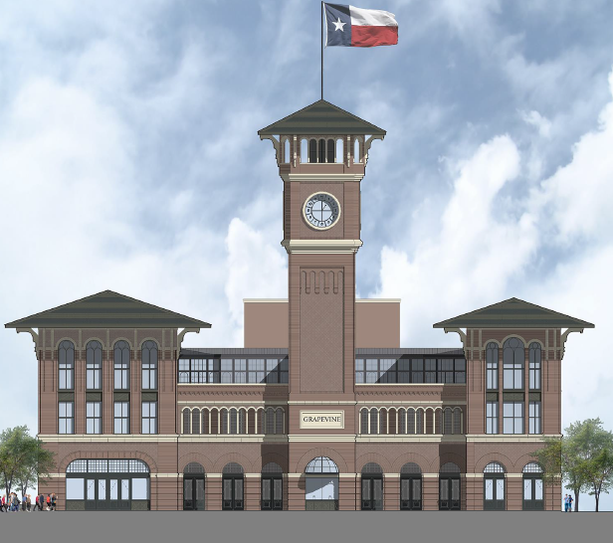
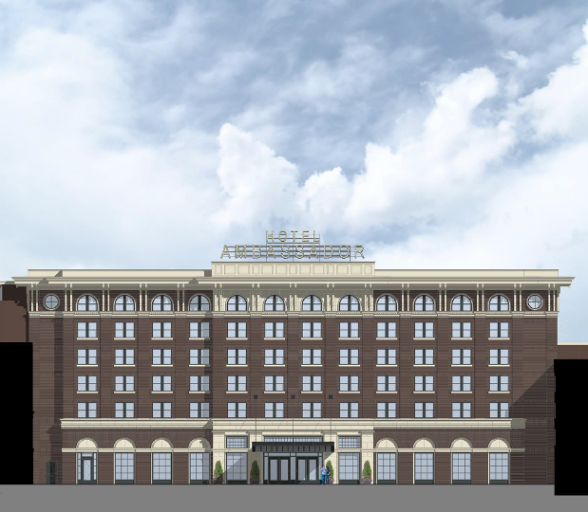
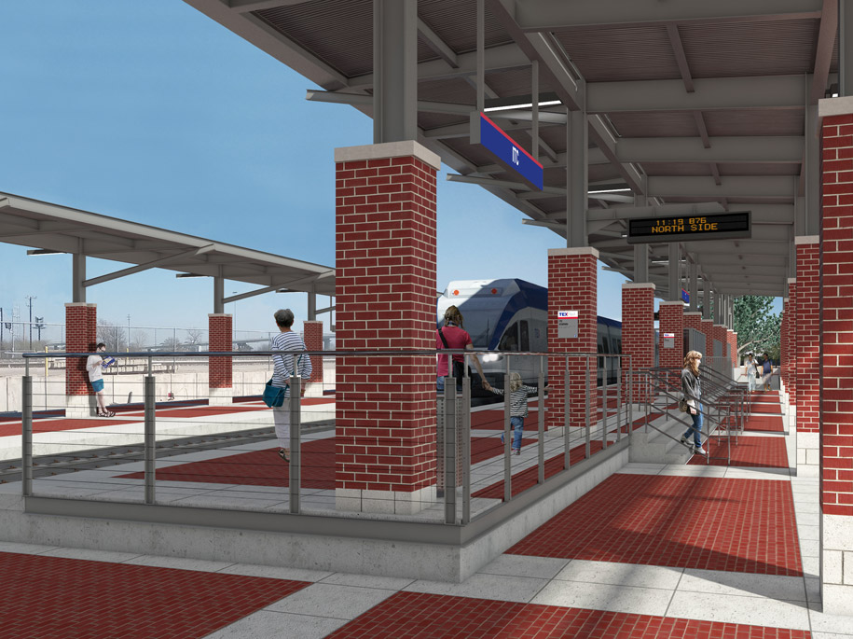
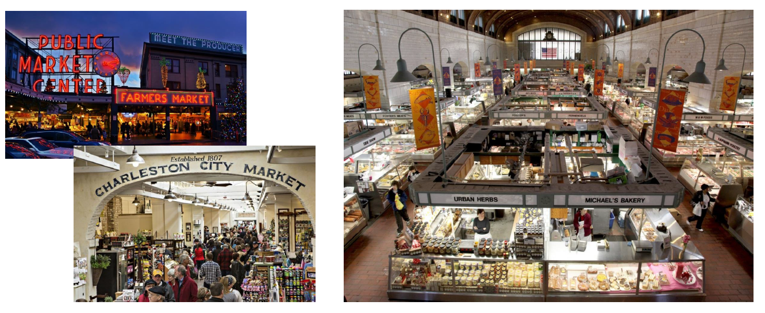
TEXRail - Grapevine
Mixed-Use Development
A station/development that will include a Marriott “Autograph” boutique hotel, food market, 6-story parking garage, public-use plaza, retail, and event space.

Slide 18
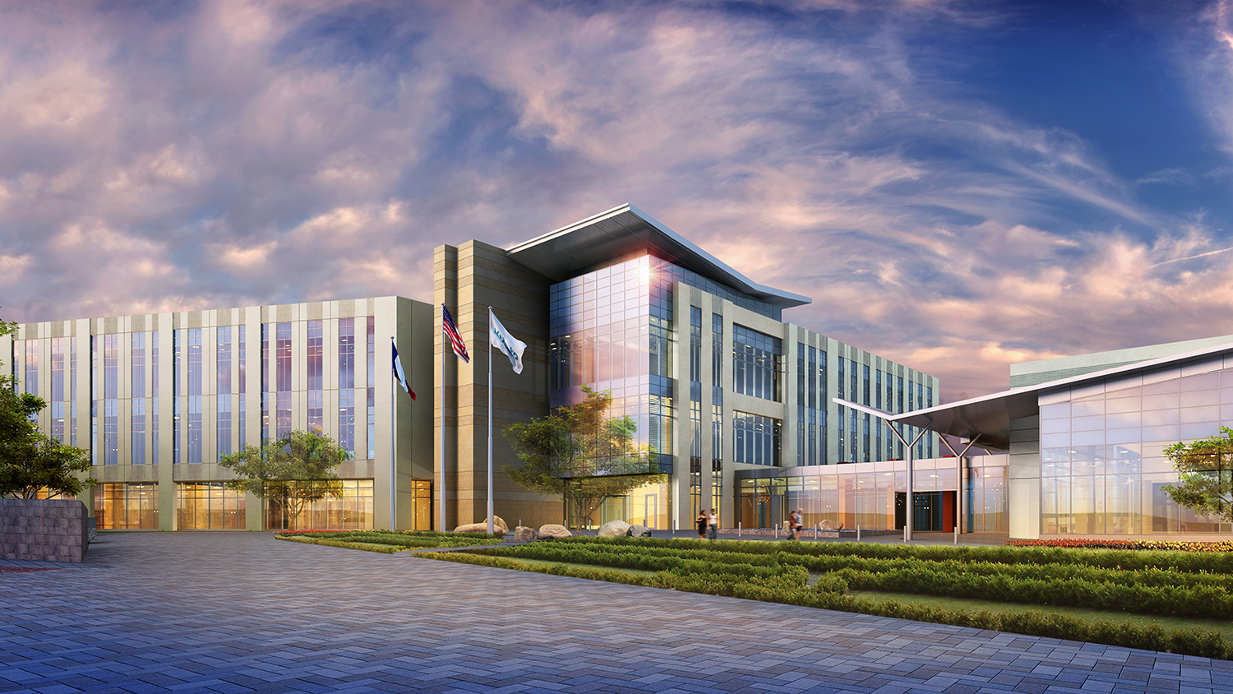
Kubota North American Headquarters
Notes:
Meeting Sales Observations:
-Fort Worth Convention Center bookings:
2017: Room Nights 116% YTD Pace, # of events +4;
2018: Room Nights 111% YTD Pace, # of events -2
2019: Room Nights 92% YTD Pace, # of events -4
-FWCVB has a 22% conversion ratio on all bookings. Being above 20% is considered positive in the destination marketing industry.

Slide 19
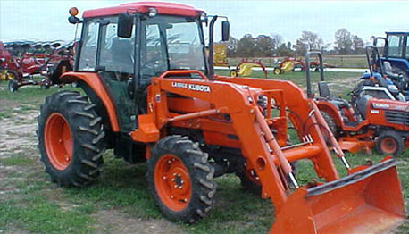
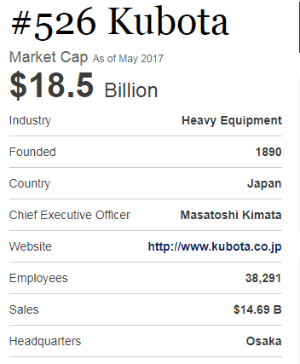
Kubota - Grapevine
$50M investment
136,000 SF of corporate office
Plans for up to 650 permanent jobs
International presence out of Japan
State-of-the-art, environmentally friendly building
Headquarters for the entire North American market; relocated to Texas from California

Slide 20
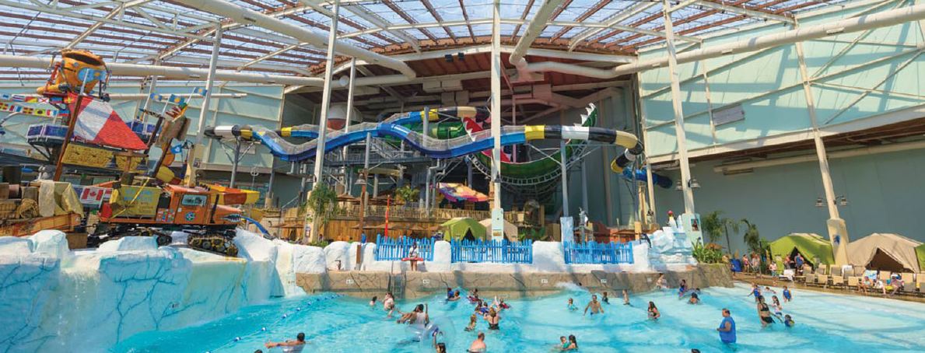
Stand Rock Hospitality
Notes:
Meeting Sales Observations:
-Fort Worth Convention Center bookings:
2017: Room Nights 116% YTD Pace, # of events +4;
2018: Room Nights 111% YTD Pace, # of events -2
2019: Room Nights 92% YTD Pace, # of events -4
-FWCVB has a 22% conversion ratio on all bookings. Being above 20% is considered positive in the destination marketing industry.

Slide 21
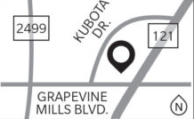
Stand Rock Hospitality
Phase 1 – 450 rooms
Phase 2 – 1,000 rooms (total)
190,000 SF
Includes a large indoor water park
Full-service restaurant in the lobby
Large amounts of event space for conferences and meetings
Helps to generate HOT tax, which feeds into the CVB, which helps attract visitors, which helps feed sales tax, which keeps local property tax down

Slide 22
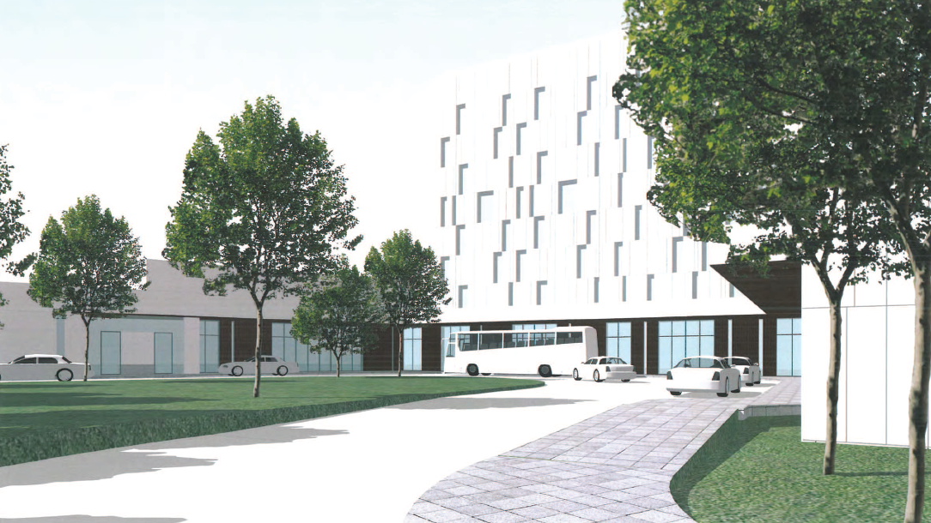
Silverlake Crossings Development

Slide 23
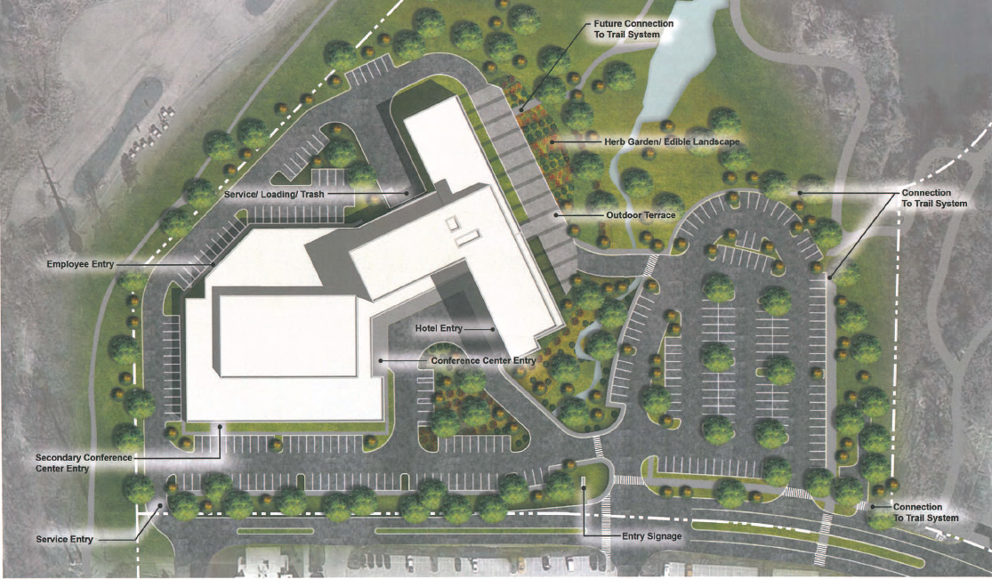
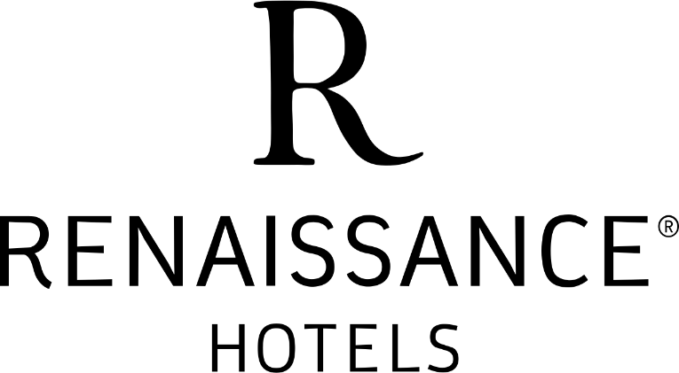
Silverlake Crossings Development
Silverlake Crossing Development
Multiple additional hotels
Office space (highly sought after in Grapevine)
Multi-family (apartments/condos)
Renaissance Hotel
300 rooms, 9 stories tall
4-Star Rating, something that fits in perfectly with nearby corporate/office users

